Slide 1
Requirements Engineering Overview
Module 1

Slide 2
Outline
What is a System?
The Need for Systems Engineering
What is Systems Engineering?
System Lifecycle
Understanding the Problem
Greenfield and Brownfield Projects
Requirements Engineering

Slide 3
What is a System?

Slide 4
What were some “systems” that you were first familiar with?
Notes:
#) seek

Slide 5
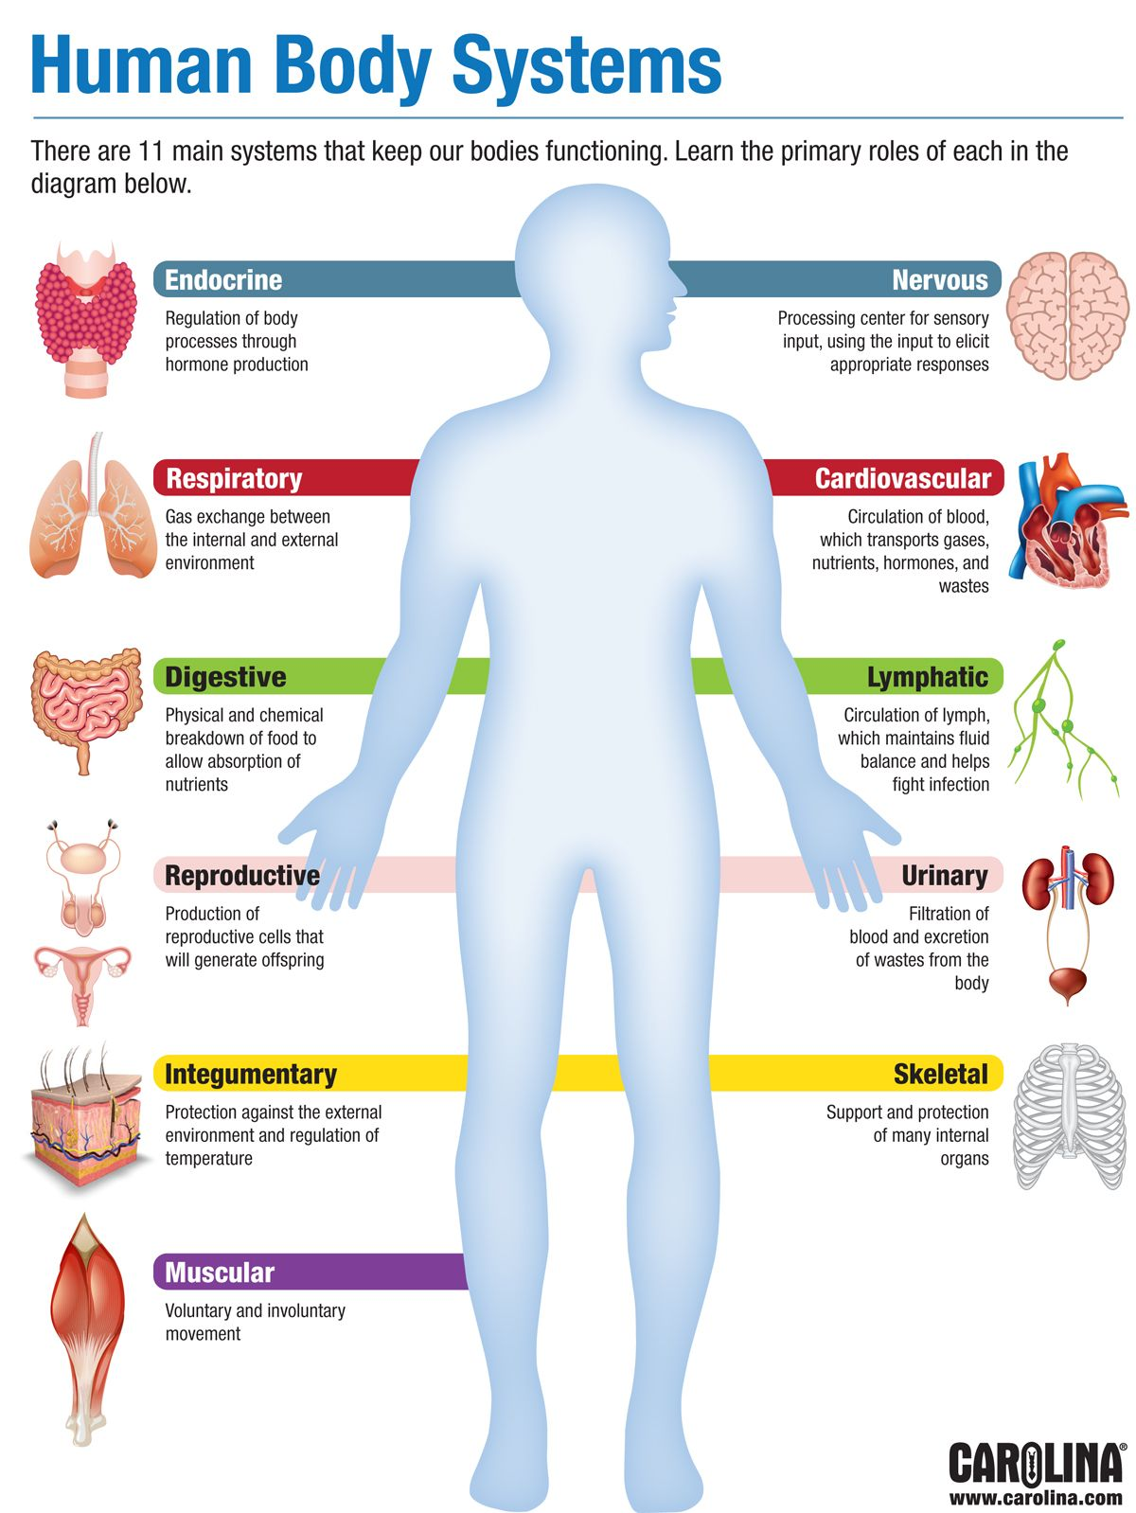

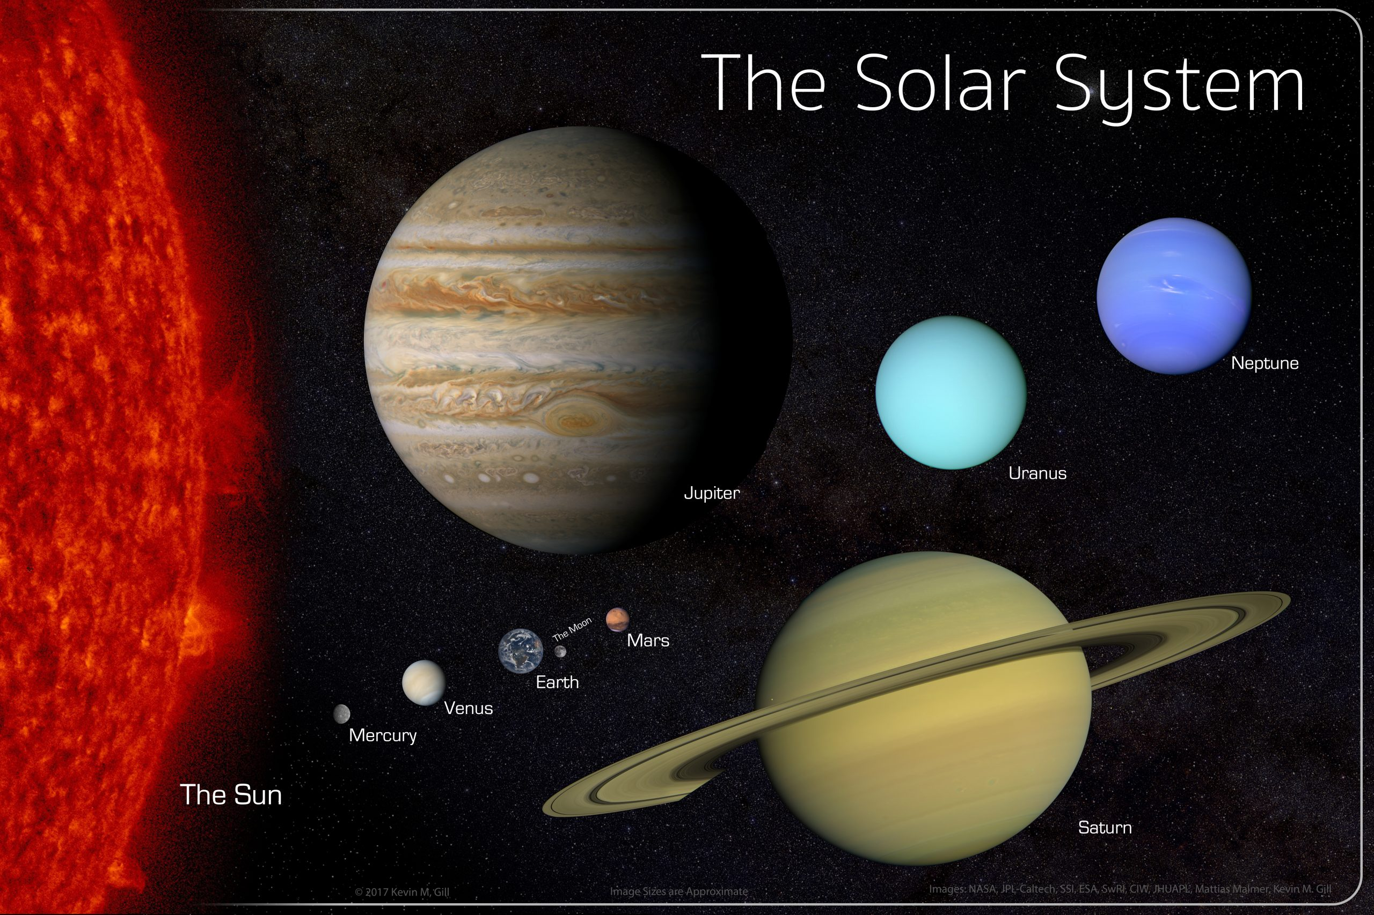


Familiar Systems
Notes:
What is common between all these examples of “systems”
How would you define a “system”
Can you give examples of “not a system”?

Slide 6
Identify “systems” in this room
What qualifies these to be “systems”?

Slide 7
A System
is
a set of elements in interaction. (von Bertalanffy 1968)
an arrangement of parts or elements that together exhibit behaviour or meaning that the individual constituents do not. (INCOSE, ISO/IEC/IEEE 15288)

Slide 8
An Engineered System
is
a system designed or adapted to interact with an anticipated operational environment to achieve one or more intended purposes while complying with applicable constraints. (INCOSE)

Slide 9
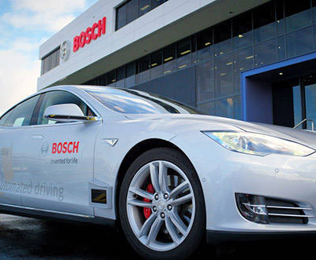
An Engineered System
has
a structure (system elements, attributes, hierarchy)
an intended behaviour (function, state)
a boundary (physical or conceptual; static or dynamic)
a life / lifecycle
a context or environment within which it exists and operates (operating environment)

Slide 10

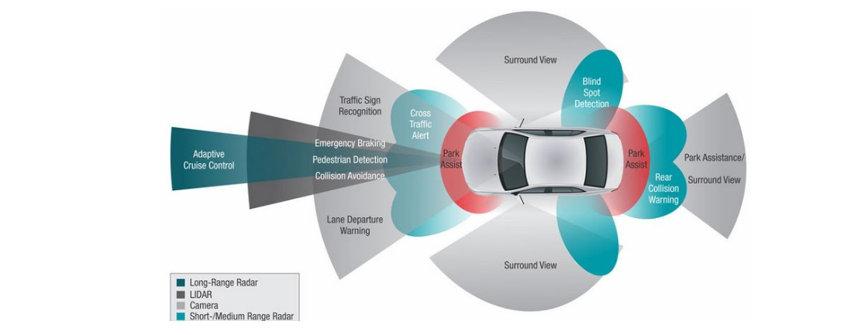
Automotive Engineered Systems
Infotainment & HUD
ADAS

Slide 11
The Need for Systems Engineering

Slide 12
Challenges in Current Landscape
Quicker, Better, Cheaper
Lesser time-to-market; no time for testing
Demand for more feature and capabilities
Lesser Cost
Rapidly changing technology
Dwindling resources, limited budget
Constantly changing requirements
Greater international competition

Slide 13


What’s the Difference?
What are some things that developers of the New-Gen Ambassador must consider that developers of Old-Gen Ambassador did not have to?

Slide 14

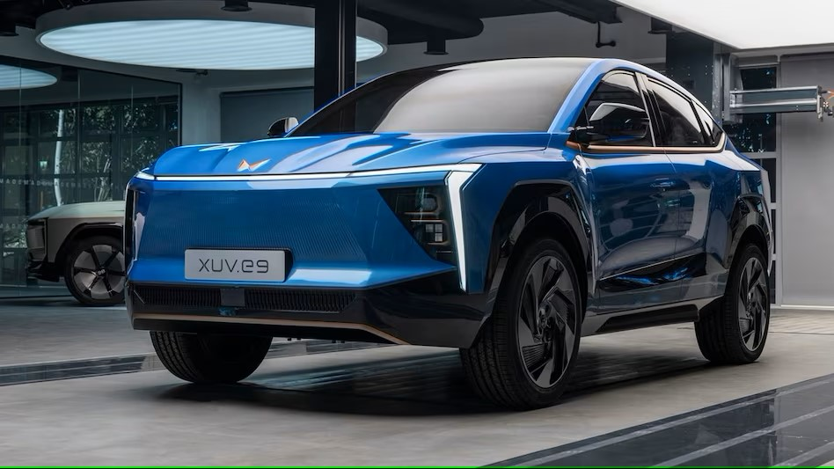
New Cars

Slide 15

New Concept Car

Slide 16
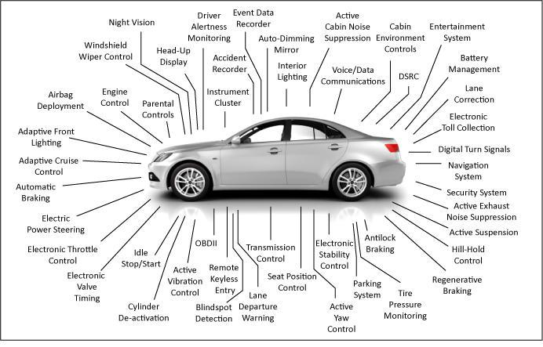
Today's Complex System
Today’s car is a multidimensional aggregation of multiple, complex electromechanical functions – each a complex system in itself – which must work closely and seamlessly with each other, and whose details are invisible to the vehicle driver.
https://www.eeworldonline.com/todays-complex-system-systems-driving-need-sophisticated-tools-detailed-modeling-data-continuity/

Slide 17
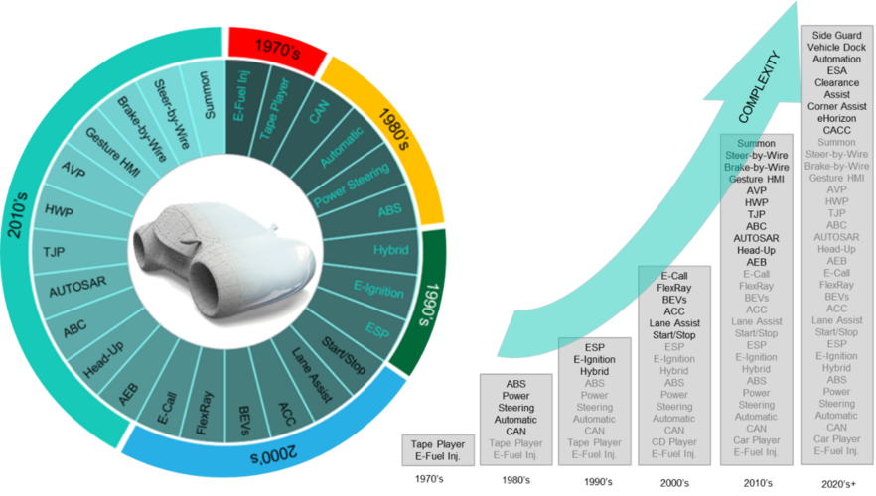
Complexity of Automotive Systems Overtime
https://www.theengineer.co.uk/content/in-depth/applying-systems-engineering-to-complex-connected-vehicles/

Slide 18
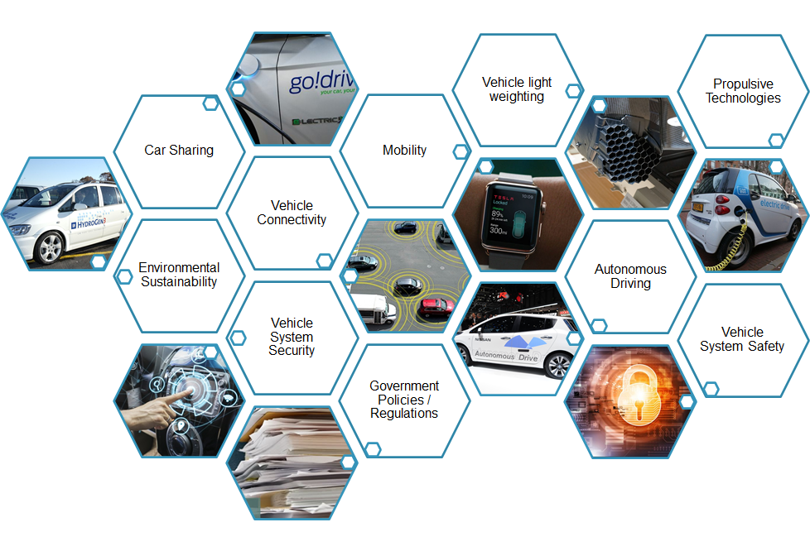
Global Automotive Trends
Population Growth and Urbanization
Aging population
Environmental factors such as air quality
Consumer attitude shift from ownership to services
Changing workforce demographics
Ubiquitous connectivity and cybersecurity

Slide 19
What is Systems Engineering?

Slide 20
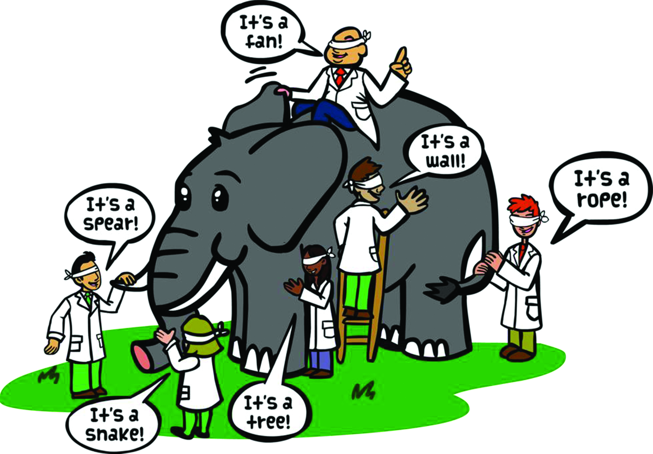
Notes:
- Flip the illustration – these are disciplinary experts who know all about their respective elements
- Where is the SEngr? What is their view?
- step in/ step out – level of detail; focus changes
- every person can step out

Slide 21
“Systems Engineering focuses on ensuring the pieces fit and work together to accomplish the objectives of the whole, across the system’s lifecycle.”
Source: Systems Engineering Book of Knowledge

Slide 22
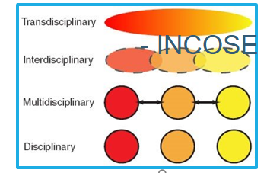
Systems Engineering
A transdisciplinary and integrative approach to enable the successful realization, use, and retirement of engineered systems, using systems principles and concepts, and scientific, technological, and management methods. (INCOSE)
Adopting an SE Approach (for system development)
Significantly Increases the Likelihood of…
Higher success rates (First time right)
Overall Cost & Time benefits

Slide 23
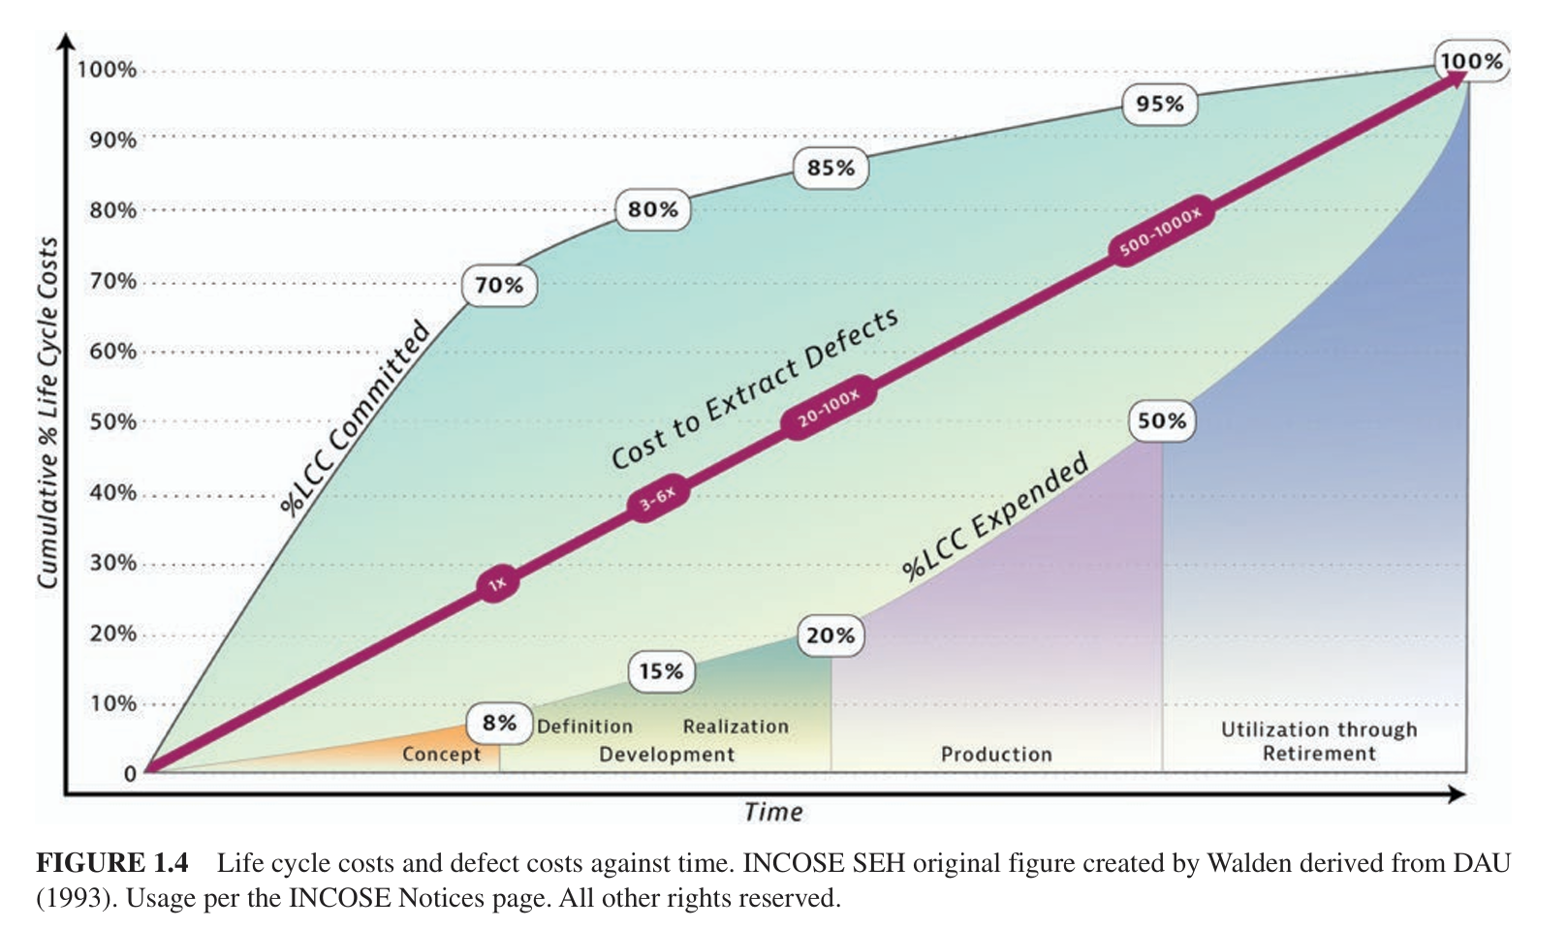
How SE benefits
Source: SE Handbook

Slide 24
Systems Engineering Impact
Cost and Time Savings
Concept & Preliminary Design
Detail Design
Implementation & Integration
Test & Qualification

Slide 25
System Life Cycle

Slide 26
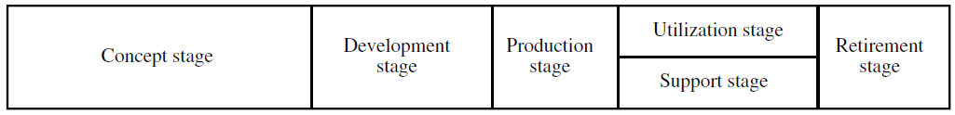
Life Cycle Stages
To effectively manage the progress of a system, its overall life is broken into stages
Generic life cycle (ISO/IEC/IEEE 15288:2023)
Life cycle stages can be executed multiple times, in parallel, and in an overlapping manner.
Decision Gates are introduced between the life cycle stages

Slide 27
Life Cycle Models
The framework within which the individual life cycle stages and transitions between them are planned and implemented
Waterfall
DevOps
V model (Sequential)
Incremental
Evolutionary

Slide 28
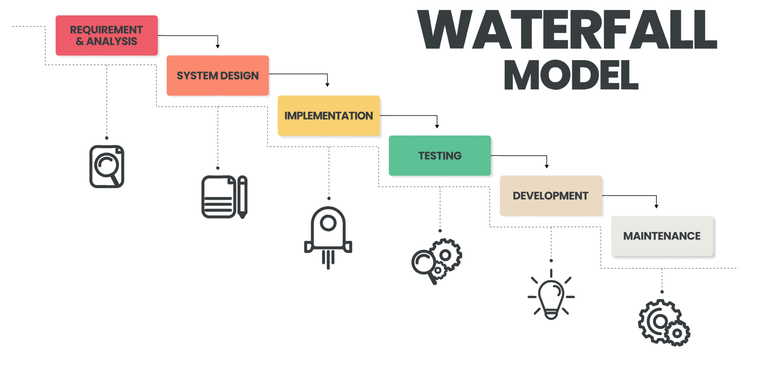
Image Source: Vecteezy

Slide 29

DevOps

Slide 30
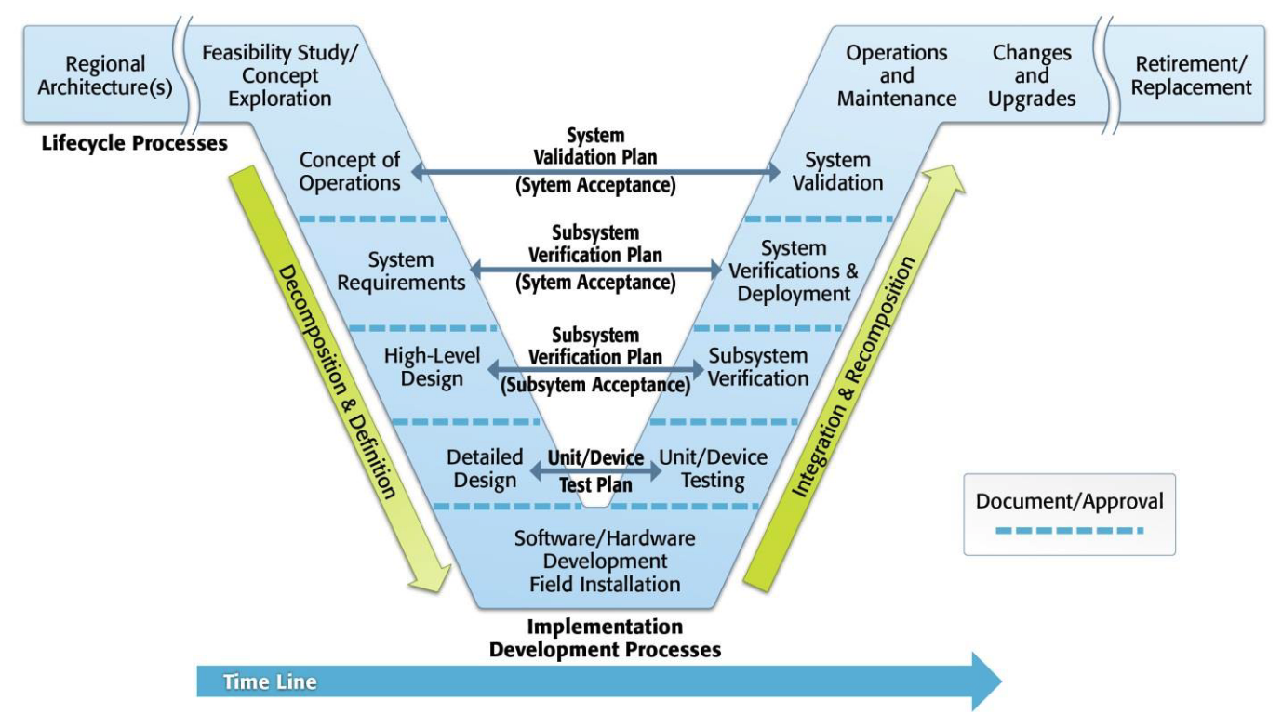
Systems Engineering V
Image source: USDOT

Slide 31
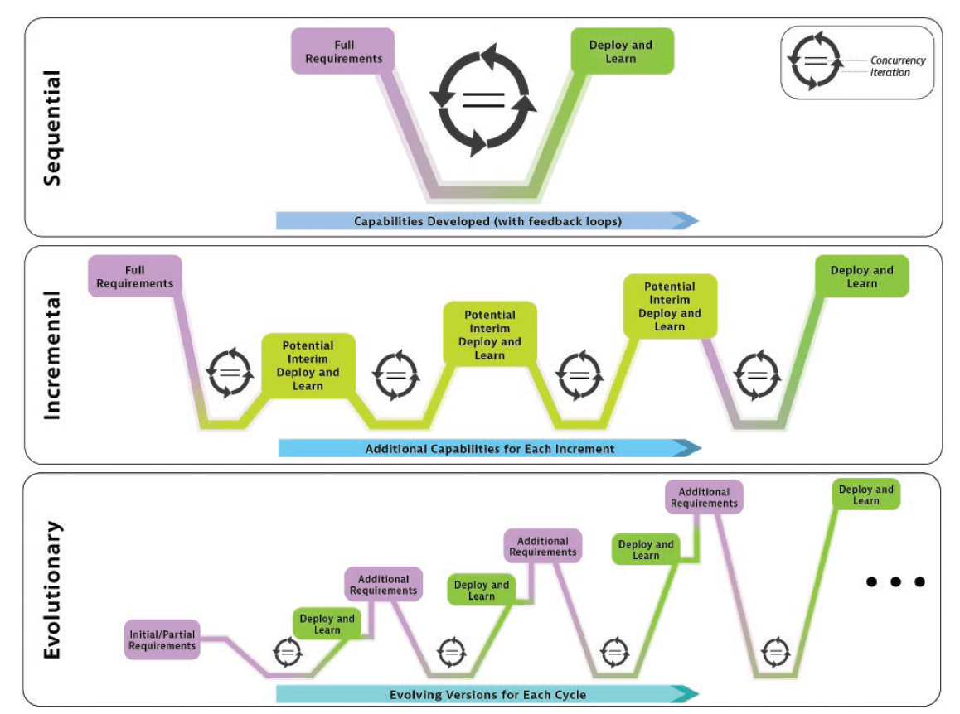
Source: INCOSE Systems Engineering Handbook, 5th edition

Slide 32
Systems Engineering Lifecycle Processes
System
Project
Organization
Source: INCOSE Systems Engineering Handbook v4

Slide 33
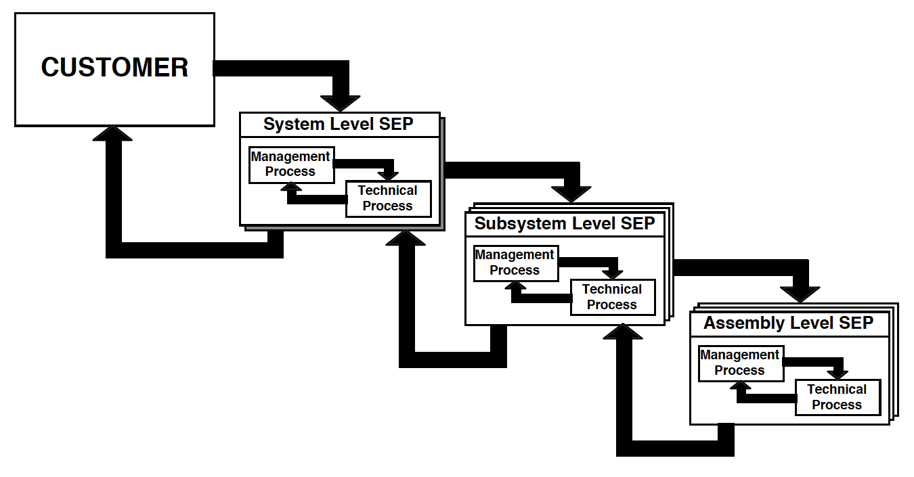
SE Process
Lockheed Martin Corporation
Notes:
Need for Tailoring
All 30 processes are not needed for every SOI, and at all levels

Slide 34
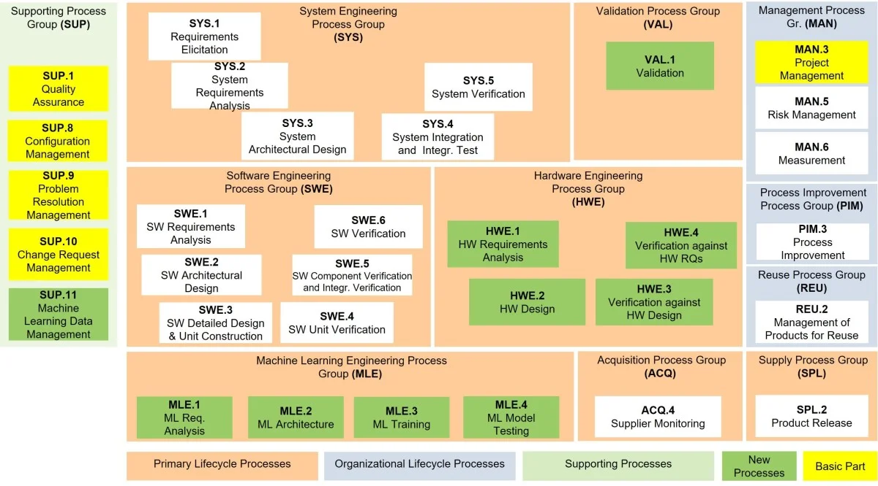
Automotive SPICE process reference model
image source: Invensity

Slide 35
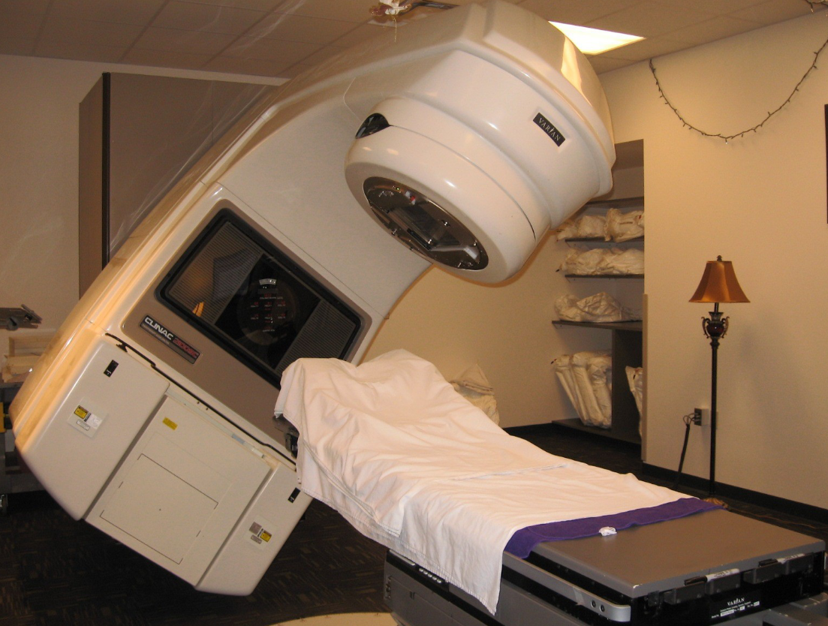
SE Case Study – Therac-25
Source: Wikipedia

Slide 36

Team Formation
https://tinyurl.com/Bosch-Hyd-Dec2024

Slide 37
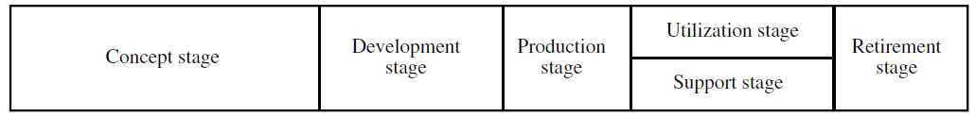
Exercise 1.1
Read “SE_CaseStudy_Therac25”
What life cycle stages can you identify?
Which stages were done well? Which not so well?
How does this case study relate to your work?
Notes:
SEND OUT:
1. SE_CaseStudy_Therac25
2. Links to individual Team Rooms (if available)
SHOW Team Formation Slide

Slide 38
System of Interest
System
Element
Element
Element
System
Element
Element
Element
System of Interest
System
Element
Element
Element

Slide 39
Understanding the Problem

Slide 40

“If I had an hour to solve a problem, I’d spend 55 minutes thinking about the problem and 5 minutes thinking about solutions.”
Albert Einstein

Slide 41
The “Problem”
Establishing and understanding the problem, is the first step for performing systems engineering
The problem establishes the need and context for an engineered solution
A problem can be defined internally (by an organization) or externally (that an organization may respond to)
Good understanding of the problem is essential to developing an effective solution

Slide 42
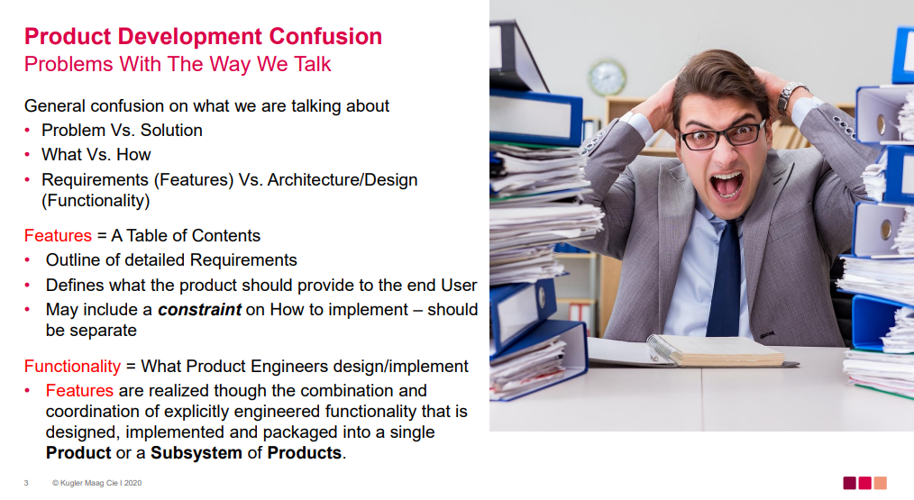

Slide 43
Greenfield and Brownfield Projects

Slide 45
Greenfield vs Brownfield Projects
Today's systems often include existing elements. It is rare to find a true "greenfield" system, in which the developers can specify and implement all new elements from scratch.
"Brownfield" systems, wherein legacy elements constrain the system structure, capabilities, technology choices, and other aspects of implementation, are much more typical (Boehm 2009).
Notes:
https://www.sebokwiki.org/wiki/Synthesizing_Possible_Solutions

Slide 46
Discussion
What are some examples of Greenfield and brownfield projects in your context?
How are requirements managed in these two cases?
What are some common challenges of Product Development in these two cases?

Slide 47
Requirements Engineering

Slide 48
What are “Requirements”?
Criteria to be met
Documented needs of what a particular product or service should be or do
“To-Do” list for the project / development team
Desired attributes of a system
Notes:
(Even though a method is usually considered to be a process itself, for the purpose of definition in this paper, we will consider processes and methods to be separate and distinct.4

Slide 49
Requirement
Every requirement represents an engineering decision as to what the SoI must do, or a quality the system must have, to meet the needs from which they were transformed.
Determination of what the system must do to meet a need is through a process of detailed requirement analysis, which can include the development and use of models, simulations, and prototypes.
A requirement statement is the result of a "formal transformation of one or more needs or parent requirements into an agreed-to obligation for an entity to perform some function or possess some quality within specified constraints with acceptable risk." (INCOSE NRM 2022).
SEBOK WIKI

Slide 50
Why do we need Requirements?

Slide 51
Requirements
Requirements are vital
Missing requirements have a cascading effect on the entire lifecycle of the project
Most requirements errors will NOT be discovered during design

Slide 52
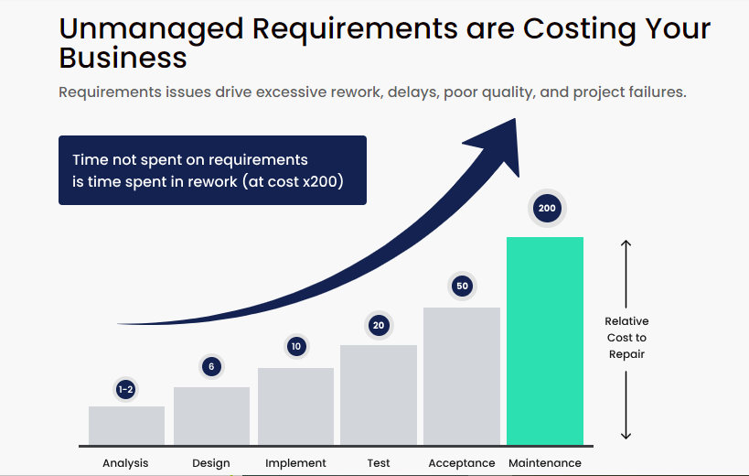
Requirements Rework Impact
Errors, detected late in the maintenance phase can cost up to 200 times more than detected early in Requirement Analysis phase
More than 40% of development budget can be consumed by poor requirements.
41% of projects fail to deliver the expected business value and ROI
49% of projects overrun original estimates
Being late to market by 6 months or more will cost organizations 33% of the 5-year ROI
https://mgtechsoft.com/blog/complete-guide-on-digital-requirements-management/

Slide 53
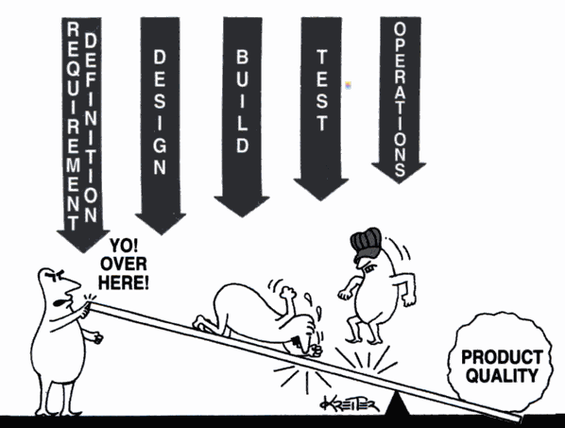
Importance of Requirements Engineering in the early lifecycle stages

Slide 54
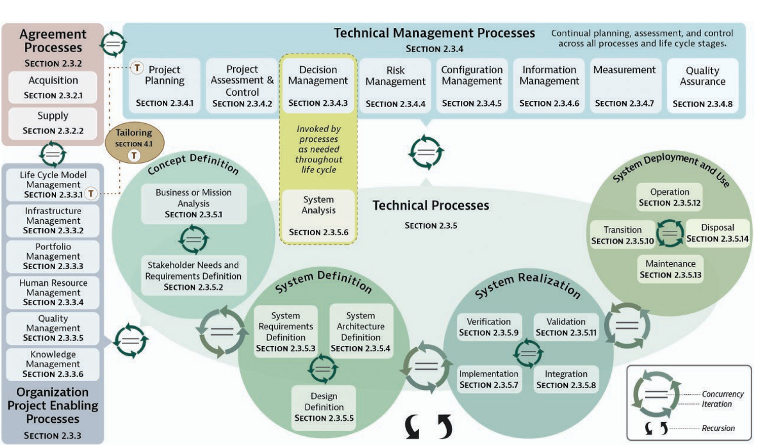
SE Processes – ISO/IEC/IEEE 15288

Slide 55
Requirements Engineering Process
Requirements Elicitation
Requirements Analysis
Requirements Communication
Requirements Management
Requirements process is applicable at every level of system development

Slide 56
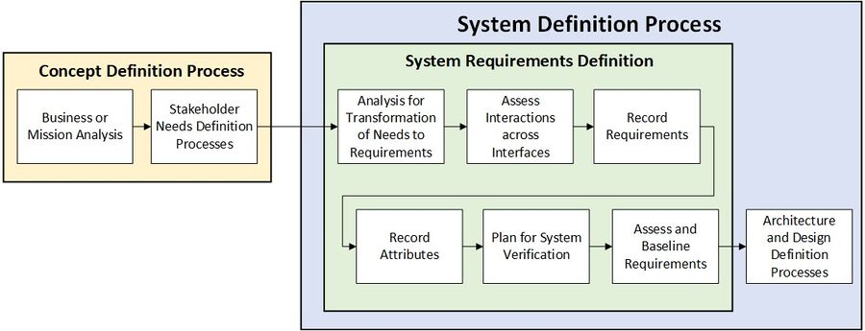
System Definition and Requirements
SEBOK WIKI

Slide 57
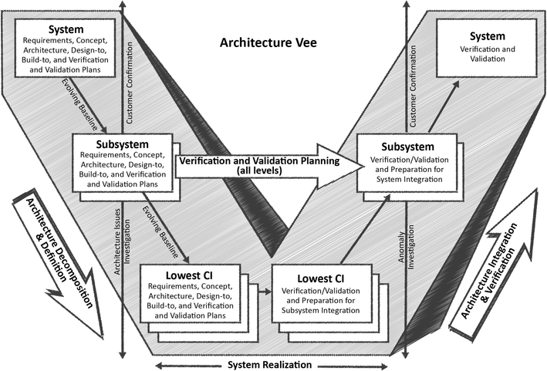
Requirements at each level
Vee model of the systems engineering process. Figure reproduced from Forsberg et al. (2005) with permission of Wiley. Copyright ©2005 by John Wiley & Sons, Inc

Slide 58
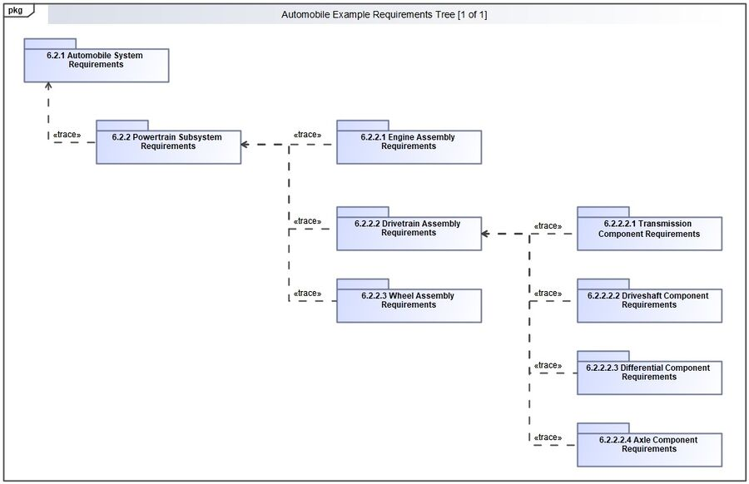
Requirements at each level
SEBOK WIKI

Slide 59
Why are Requirements Textual?
Not everyone can interpret/understand non-textual representations
Diagrammatic or model representation will have to be supported by detailed textual statements and descriptions to be understood unambiguously
Structured natural language with rules reduces ambiguity in textual statements
Textual representations are universal – can express non-functional requirements, qualities, regulations, and standards
Textual representations are accessible to everyone (no tools, licenses, etc.)
Attributes can be easily used to manage textual requirements
More easily understood in a formal agreement involving non-technical stakeholders

Slide 60
The End

